Slide 1
Conservation Easement
Case Study
How a Camp in Texas Protected their Land Forever and Generated $3.5 Million

Slide 2
What is a Conservation Easement?
A conservation easement conserves natural land for generations while realizing some of the monetary value of the land now. In exchange for committing to never subdivide or develop a significant portion of the John Knox Ranch property, we will receive substantial funds to use for camp ministry in Mission Presbytery.

Slide 3
Why are we setting up a Conservation Easement?
Fulfills two major goals:
Permanent protection for the land of John Knox Ranch (mostly from ourselves!)
Permanent protection for the camp and retreat ministry program through the creation of an endowment with funds generated from the conservation easement.

Slide 4
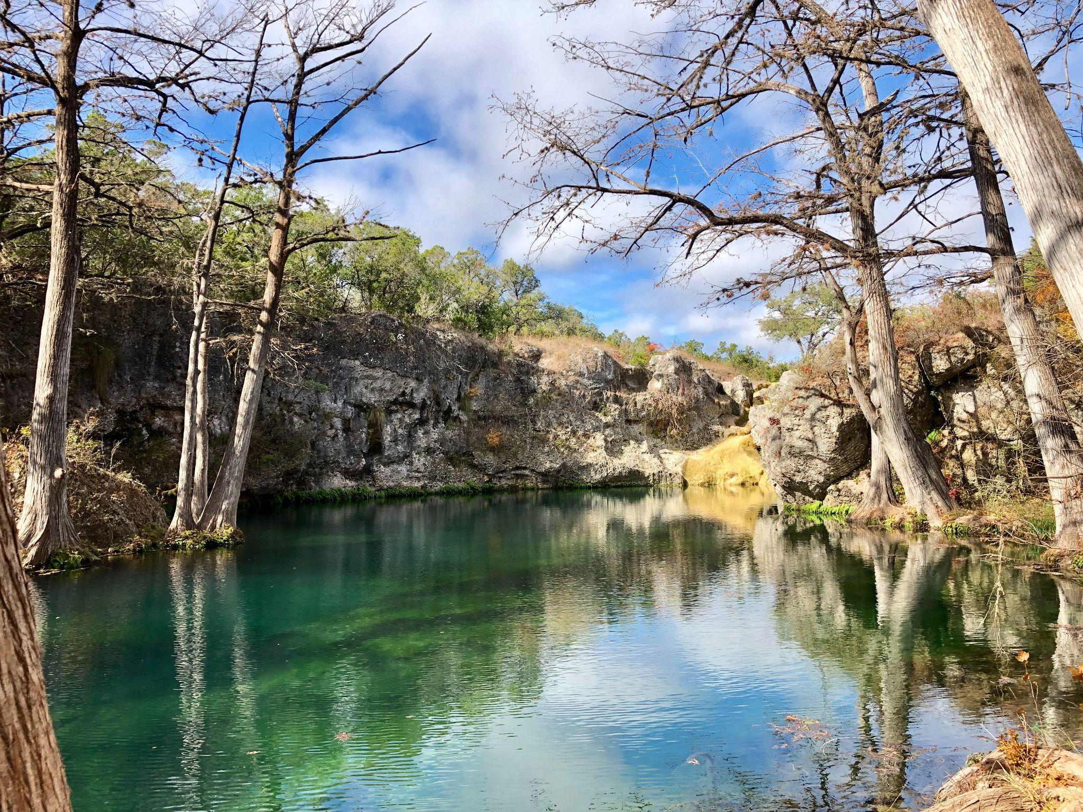

Slide 5
Start with Strategic Planning
Determine if a Conservation Easement is right for your camp
Does a CE fit the mission? “Foster experiences of Christian community in the beauty of God’s creation”
Engage Board, Committee, Governing Body
Organization should be financially healthy. Not a last ditch effort to save camp from closing
Patience is key! This is a long process. We are in year 5 and recently had a timeline setback
Find similar organizations that have established a conservation easement and interview them

Slide 6
Find a Land Trust Partner
A Land Trust is a nonprofit that conserves natural land
Interview 3-5 land trusts that work in your area at your site
Look for a land trust with a good reputation
Are they easy to work with? Do you enjoy working with them?
Get to know your main contact well. I hiked the “property line” trail for 2 hours with the Chief Conservation Officer of HCC
Land Trust is responsible for driving the project including funding
You are marrying your organizations for life!
Annual site visit. Long term partner!
Pledge to land trust for their endowment. We did $50k

Slide 7
Process
Find a lawyer who specializes in Conservation Easements to represent your organization
Site survey (ours cost $14k)
CE appraisal. Find an expert. We ended up doing 3 different appraisals
You will need to pay for appraisal and survey up front
Help with funding/grant writing?

Slide 8
Funding
Land Trust should lead
Our CE funding: Hays County Conservation Bond, Comal County, Texas Parks and Wildlife, USDA Natural Resources Conservation Service, Trull Foundation, Hershey Foundation
Because we are a nonprofit, I helped write some grants
Find foundation that will support ‘closing costs’
Donate a portion? Tax deduction for individual. We said no.
The more funders you have, the more people have to sign off on CE governing doc and may want to add things.

Slide 9
Working with a Governing Body (Presbytery)
JKR is owned and operated by Mission Presbytery a group of over 100 churches.
Educate! CE FAQ. Give reports often
2020 vote on the floor of Presbytery meeting. Motion language included funds designated to JKR
Long process! 5 years in….and counting!
After CE doc complete, review with Trustees, Fiscal Oversight, JKR committee, General Council with our lawyer
Lots of meetings, lots of committee approvals

Slide 10
Conservation Easement Governing Document
The CE document is a long legal document that governs the whole agreement
Your land trust will have a template to start with
Many meetings going over the CE doc with land trust and lawyers
Map (255 out of our total 300 acres)
Building envelopes
Baseline report

Slide 11
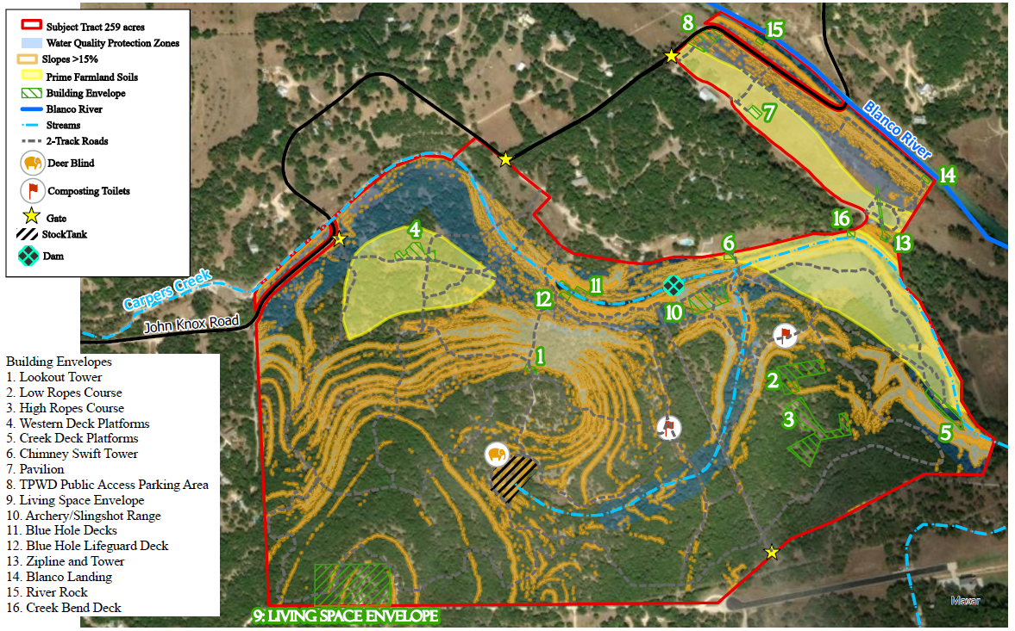

Slide 12
Our Easement in a Nutshell
We will forever protect 255 out of a total of 300 acres of John Knox Ranch. These 255 acres includes our precious Blue Hole spring, river frontage, flood plain area, and heavily wooded “nature preserve” area south of the creek.
In return for setting up the easement, there is a cash payout of $3,570,000 which will be used to benefit camp ministry in Mission Presbytery through long-range planning and site upgrades as well as setting up an endowment with Texas Presbyterian Foundation.
We will mostly be able to use the land the same way we have for the last 62 years of ministry. The two main restrictions are development and subdivision.
There are several “Building Envelopes” in the easement area in which we can make repairs or build new facilities if we ever need/want.

Slide 13
JKR Easement Continued
We retain the rights to create hiking trails, add wayfinding and educational signage, build new campsites, repair all existing structures (ropes course, lookout point, etc.), and trim trees and vegetation as needed.
Hill Country Conservancy will be our long-term partner helping us to manage the easement, develop and enact a land management plan, and make sure we don’t break any rules!
We retain full rights to develop and build on the remaining 45 acres of the property which is where all of the current buildings and utilities are located. We have locations picked out for any future buildings we may need. I.e. (Dining hall location out of the flood plain, more duplex cabins, lodge-style building).

Slide 14
Impact of Funding. $3.5 Million
Create a $1.7 million endowment for camp ministry at John Knox Ranch which will generate $85,000 per year for operating budget.
Plan for our future through strategic planning and master site planning
Invest in the site and facilities of John Knox Ranch
We are also setting aside $350,000 to directly benefit Mission Presbytery through the creation of a $200,000 church retreat scholarship fund and a gift of $150,000 to the presbytery budget.

Slide 15
Is a Conservation Easement right for your site?
Minimum acreage, Ecologically sensitive, high development pressure
Financial health
Strategic Planning
Mission Fit
501c3 or good relationship with governing body
Questions???
Contact: Henry Owen jkrdirector@missionpby.org
More info https://johnknoxranch.org/conservationeasementatjkr

