Slide 1
AS YOU ENTER…
Circulate around the room reading the job descriptions on each chair. Sit in a chair with a job you’d be willing to do
for us today.

Slide 2
Building Community
With Youth and the Congregation
10 Strategies and Tools YOU Can Use!
Tivvi Pare
(she/her)
Notes:
My background in community building at HC and in the classroom

Slide 3
Before we get started…
Let’s Check in!
How are you feeling at this moment?
How has your day been so far?
How much do you already know about how to build a community?
Notes:
My background in community building at HC and in the classroom

Slide 4
A Case for Community
Notes:
Teaching 5th grade during COVID, expected huge drop in test scores and increase in mental health challenges. Built community in the classroom. Yes test scores still dropped, mental health was still a challenge. We were more resilient, we trusted each other, we were seen and valued for our whole selves.
Camp story: Molly on the saxophone

Slide 5
A Case for Community
Horton Center is a place where people can grow in their faith and feel respected, loved, welcomed and valued. Do you agree with this statement? Why or why not?
Notes:
Teaching 5th grade during COVID, expected huge drop in test scores and increase in mental health challenges. Built community in the classroom. Yes test scores still dropped, mental health was still a challenge. We were more resilient, we trusted each other, we were seen and valued for our whole selves.
Camp story: Molly on the saxophone

Slide 6
A Case for Community
Horton Center is a place where people can grow in their faith and feel respected, loved, welcomed and valued. Do you agree with this statement? Why or why not?
Yes everyone felt welcomed and loved. - Middle School camper
Notes:
Teaching 5th grade during COVID, expected huge drop in test scores and increase in mental health challenges. Built community in the classroom. Yes test scores still dropped, mental health was still a challenge. We were more resilient, we trusted each other, we were seen and valued for our whole selves.
Camp story: Molly on the saxophone

Slide 7
A Case for Community
Horton Center is a place where people can grow in their faith and feel respected, loved, welcomed and valued. Do you agree with this statement? Why or why not?
Yes everyone felt welcomed and loved. - Middle School camper
Yes. The staff members and kids are really nice, and it's a very good community. - High School camper
Notes:
Teaching 5th grade during COVID, expected huge drop in test scores and increase in mental health challenges. Built community in the classroom. Yes test scores still dropped, mental health was still a challenge. We were more resilient, we trusted each other, we were seen and valued for our whole selves.
Camp story: Molly on the saxophone

Slide 8
A Case for Community
Horton Center is a place where people can grow in their faith and feel respected, loved, welcomed and valued. Do you agree with this statement? Why or why not?
Yes everyone felt welcomed and loved. - Middle School camper
Yes. The staff members and kids are really nice, and it's a very good community. - High School camper
Yes people made me feel comfortable, safe, and valued. Elementary camper
Notes:
Teaching 5th grade during COVID, expected huge drop in test scores and increase in mental health challenges. Built community in the classroom. Yes test scores still dropped, mental health was still a challenge. We were more resilient, we trusted each other, we were seen and valued for our whole selves.
Camp story: Molly on the saxophone

Slide 9
A Case for Community
What was the best part of your week?
Notes:
Teaching 5th grade during COVID, expected huge drop in test scores and increase in mental health challenges. Built community in the classroom. Yes test scores still dropped, mental health was still a challenge. We were more resilient, we trusted each other, we were seen and valued for our whole selves.
Camp story: Molly on the saxophone

Slide 10
A Case for Community
What was the best part of your week?
I learned how to work with people and build stronger relationships - Elementary camper
Notes:
Teaching 5th grade during COVID, expected huge drop in test scores and increase in mental health challenges. Built community in the classroom. Yes test scores still dropped, mental health was still a challenge. We were more resilient, we trusted each other, we were seen and valued for our whole selves.
Camp story: Molly on the saxophone

Slide 11
A Case for Community
What was the best part of your week?
I learned how to work with people and build stronger relationships - Elementary camper
Loved hanging out with friends, new and old. - Middle School camper
Notes:
Teaching 5th grade during COVID, expected huge drop in test scores and increase in mental health challenges. Built community in the classroom. Yes test scores still dropped, mental health was still a challenge. We were more resilient, we trusted each other, we were seen and valued for our whole selves.
Camp story: Molly on the saxophone

Slide 12
A Case for Community
What was the best part of your week?
I learned how to work with people and build stronger relationships - Elementary camper
Loved hanging out with friends, new and old. - Middle School camper
The closeness of my group and how we grew together. - High School camper
Notes:
Teaching 5th grade during COVID, expected huge drop in test scores and increase in mental health challenges. Built community in the classroom. Yes test scores still dropped, mental health was still a challenge. We were more resilient, we trusted each other, we were seen and valued for our whole selves.
Camp story: Molly on the saxophone

Slide 13
But why Christian community?
“An engaged spiritual life enhances grit, optimism, and resilience while providing insulation against addiction, trauma, and depression.” - Dr. Lisa Miller PhD., author of The Awakened Brain
Notes:
Teaching 5th grade during COVID, expected huge drop in test scores and increase in mental health challenges. Built community in the classroom. Yes test scores still dropped, mental health was still a challenge. We were more resilient, we trusted each other, we were seen and valued for our whole selves.
Camp story: Molly on the saxophone

Slide 14
Your
Handout

Slide 15
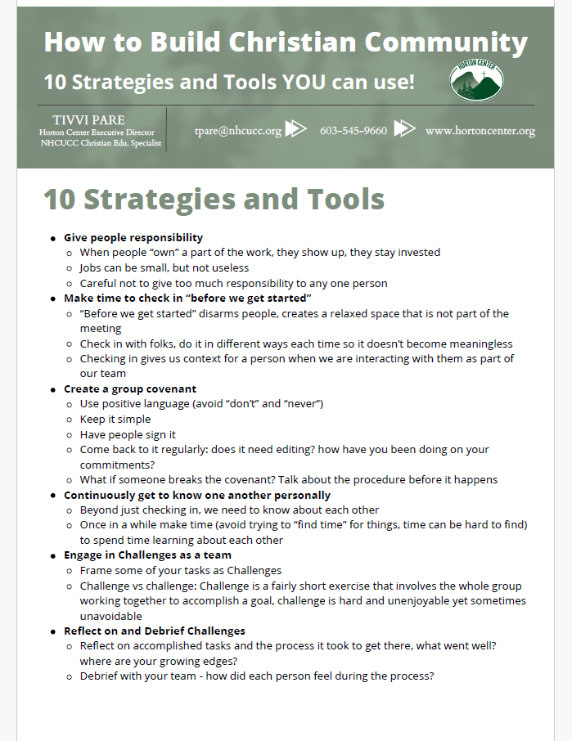
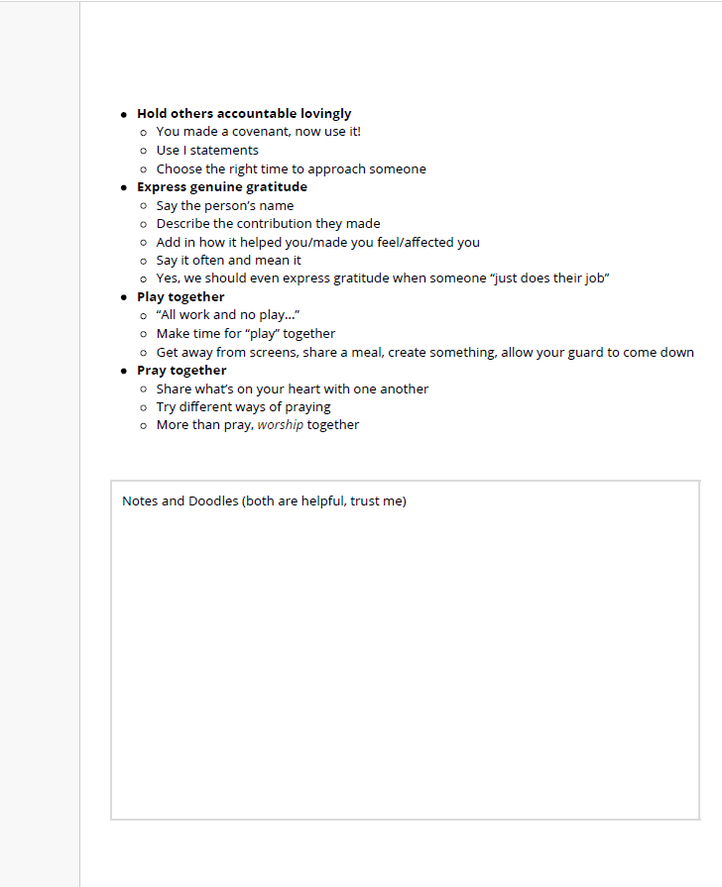

Slide 16
Goals & Outcomes
10 strategies that you can pick and choose from
10 tools that you could use towards those strategies
An understanding of the importance of community building
Begin planning for how to take this work into your groups
HAVE FUN!
Notes:
Teaching 5th grade during COVID, expected huge drop in test scores and increase in mental health challenges. Built community in the classroom. Yes test scores still dropped, mental health was still a challenge. We were more resilient, we trusted each other, we were seen and valued for our whole selves.
Camp story: Molly on the saxophone

Slide 17
Group Sharing
ELBOW to ELBOW
What groups, teams, committees, etc.
are you a part of?

Slide 18
Group Sharing
KNEE to KNEE
Describe a time when you felt really
connected with a community.

Slide 19
Group Sharing
TOE to TOE
What is one way you think community
members should feel?
What is one way you think
community members
should act?

Slide 20
How to Build
Christian Community
10 Strategies and Tools YOU Can Use!
Strategies vs Tools
Notes:
We’ve already covered three of my strategies! What were they? Job descriptions, Checking in “before we get started”, creating a covenant
You’re not going to use all 10 every day, you might not even use all 10.Give yourself permission to find just a few things to implement.

Slide 21
Give people responsibility
Responsibility -> taking ownership
Jobs can be small, not useless
Evenly distribute responsibility
Notes:
We’ve already covered three of my strategies! What were they? Job descriptions, Checking in “before we get started”, creating a covenant
You’re not going to use all 10 every day, you might not even use all 10.Give yourself permission to find just a few things to implement.

Slide 22
Make time to check in
“Before we get started”
Try new ways of checking in
Gives context of the people we are with
Notes:
We’ve already covered three of my strategies! What were they? Job descriptions, Checking in “before we get started”, creating a covenant
You’re not going to use all 10 every day, you might not even use all 10.Give yourself permission to find just a few things to implement.

Slide 23
Get to Know One Another
It’s not rocket science, I know, but do you take time to get to one your group mates every time you’re together?

Slide 24
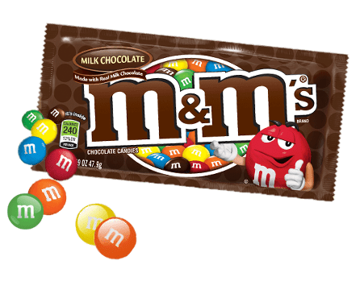
M&Ms
Red -A book/movie/tv show you like
Orange - A pet peeve of yours
Yellow - Dream vacation destination
Green - Something you’re good at
Blue - Someone you admire/look up to
Brown - A restaurant you like

Slide 25
Engage in Challenges Together!
What?!
Isn’t community at its best when things are easy?

Slide 26
Switch
Change
Reverse

Slide 27
Reflect/
Debrief After Challenges

Slide 28
Roses
and
Thorns

Slide 29
Hold Others Accountable to the Covenant
Okay, so you made a covenant.
Now what?

Slide 30
Using
I statements

Slide 31
Express
Genuine Gratitude

Slide 32
Name
Their Contribution
How it helped/made you feel/affected you
Hey, _____, thank you for _________ it really helped me __________.

Slide 33
Play Together

Slide 34
Rock
Paper
Scissors
YEAH!

Slide 35
Pray Together

Slide 36
Conclusion

Slide 37
QUESTIONS?
Contact Tivvi!
TPare@nhcucc.org
603-545-9660

