Slide 1
Resilient Leadership: Aligning Mind, Body, and Spirit
Campfire Collective Annual Conference
Rev. Regina C. Groff, Ph.D.
Director, Education for Wholeness

Slide 2
Welcome!
You belong here.

Slide 3
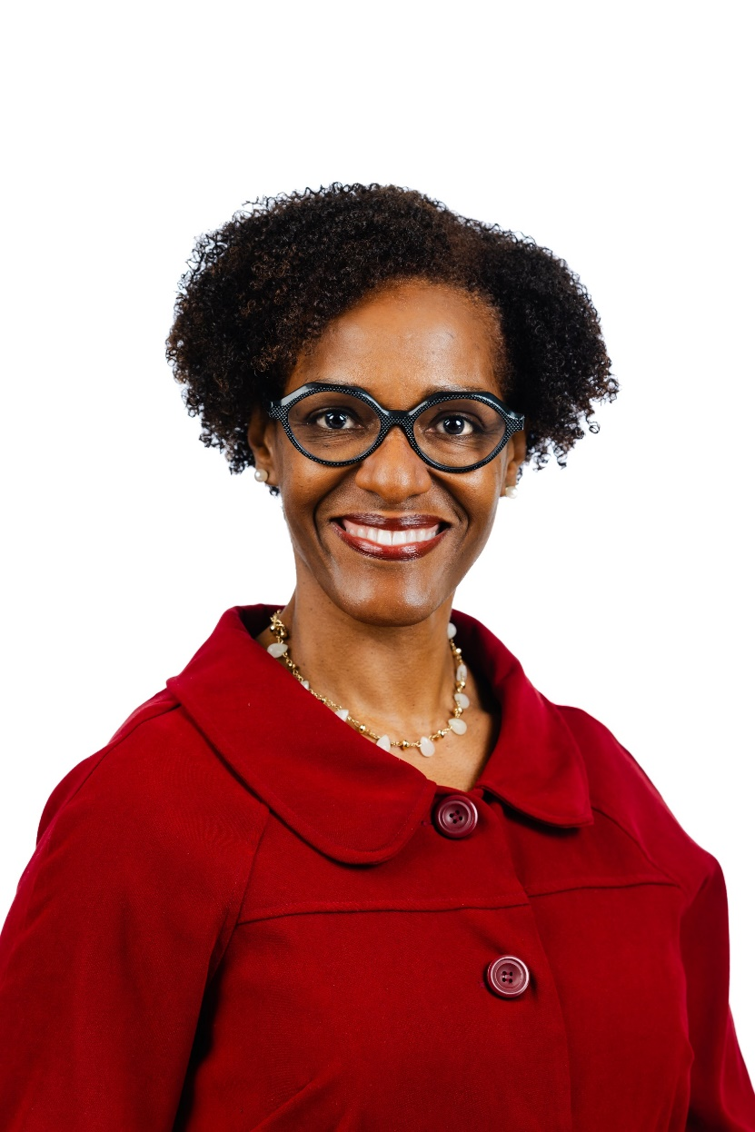
About the Presenter
Rev. Regina C. Groff, Ph.D.
B.A., M.Div., Ph.D.
Director, Education for Wholeness, Board of Pensions PC (USA)
25+ years in ordained ministry
Brooklyn girl
Faith, Family, Fun
3

Slide 4
Session Objectives
Discuss the value of prioritizing rest, release, and renewal.
Examine the connection between leading well and caring for self.
Explore tools and practices to maintain harmony between the mind, body, and spirit.
Develop self-care plans to enable us to lead and support our teams effectively.

Slide 5
Group Covenant
How we will interact
Respect: Treat one another with kindness and consideration, maintain privacy, and respect boundaries.
Empathize: Actively listen, acknowledge feelings, and validate experiences.
Be open: Be willing to learn and grow by embracing new ideas, perspectives, and experiences.
Engage: Participate in activities and discussions, but also respect your own need for rest and reflection.

Slide 6
Resilience
.

Slide 7
Defining Resilience
The ability to bounce forward after painful experiences
The ability to sustain purpose, energy, and direction despite difficulties
The proclivity to see a challenge as an opportunity
What is resilience?
7

Slide 8
Why Resilient Leadership?
Navigate Complexity
Amid uncertainty—societal changes (policies, economy, leadership), organizational shifts (staffing changes, diminishing resources, budgetary shortfalls), personal transitions (family, job loss, health challenges)—resilience equips leaders to adapt quickly without losing momentum.
Support through Challenging Times
Resilience sets the foundation for how to effectively guide and support your team during both harvest and challenging times.
Foster Innovation
Demonstrating resilience in the face of challenges creates environments where innovation is not only welcomed but is possible.
8

Slide 9
“Do not judge me by my success, judge me by how many times I fell down and got back up again.”
– Nelson Mandela

Slide 10
Aligning Mind, Body, Spirit
Body
Mind
Spirit
Physical wellness, energy, and balance.
Clarity of thought, decision-making, and emotional intelligence.
Purpose, values, and a sense of connection to something greater/higher power.

Slide 11
“The fact is that if we're not intentionally finding ways to increase and renew our energy, we're depleting ourselves. If we're not getting stronger, we're getting weaker.”
-Tony Schwartz, The Energy Project

Slide 12
Activity
How “well” is your well-being?
Just as you encourage your team to practice self-care,
you too must be intentional about your own well-being.

Slide 13
A Balancing Act

Slide 14
First Love
Your first love was YOU.

Slide 15
Strengthening the Mind
What’s your go-to?
Meditation
Deep breathing
Setting intentions
Reframing negative thoughts
Learning and curiosity
Brain plasticity
Therapy, spiritual direction, coaching

Slide 16
Guided Meditation

Slide 17
Resilience and Physical Health
How does physical health impact our leadership?
“Take care of your body. It’s the only place you have to live.”
– Jim Rohn
Boosts stamina and vitality
Helps manage stress more effectively
Sharpens mental clarity and focus
Supports healing from trauma

Slide 18
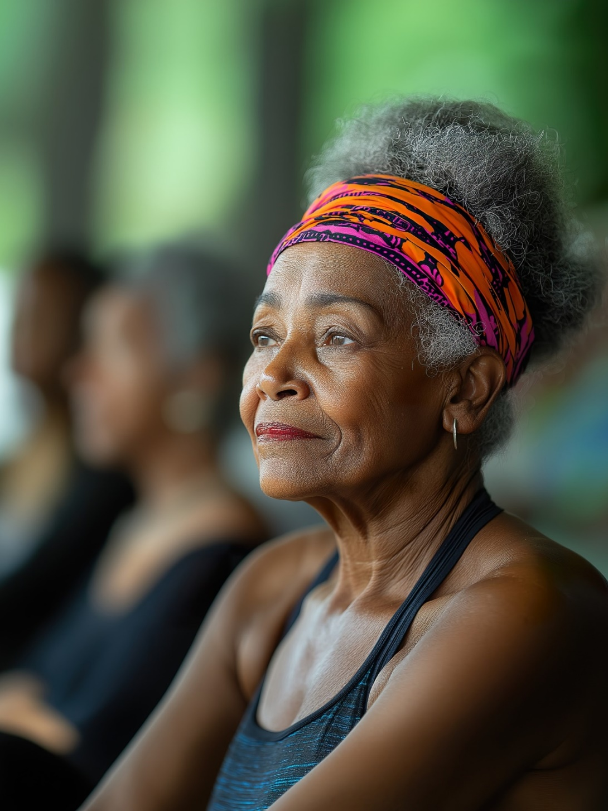
Caring for the Body
Top 6
Sleep
Nutrition
Exercise
Drink water
Preventative care
Mental and emotional care
18

Slide 19
Let’s Move!
Physical Activities
Walking
Running
Swimming
Stretching
Yoga
Dancing
Strength
HIIT/Circuit
Skating
Sports
*Use your fitness app or watch.
Pay attention to your “Stand” and “Move” rings (Apple).

Slide 20
Let’s Move (Really)

Slide 21
Nurturing the Spirit
Connection
The alignment between your spirit, and your purpose and values helps leaders stay connected to what and who truly matters.
Purpose provides direction
Purpose allows you as a leader to understand the "why" behind your actions.
Values guide our decision-making
Our values are the core principles that guide behavior, decisions, and interactions.
21

Slide 22
What are YOUR core values?

Slide 23
Grounding the Spirit
Quiet Reflection
Journaling
Prayer
Meditation
Readings
Art
Music
Sabbath

Slide 24
Sabbath
“Sabbath is that uncluttered time and space in which we can distance ourselves from our own activities enough to see what God is doing.”
— Eugene H. Peterson
Rest
Restores physical and mental energy
Reflection
Creates space for reflection and spiritual nourishment
Balance
Models a commitment to balance and boundaries

Slide 25
Bringing it All Together
Self-Care Plan
What are small habits you can begin now
to lead to big changes later?

Slide 26
Questions?

Slide 27
Resources
Mental health resources
pensions.org/what-we-offer/benefits-guidance/mental-health-resources
The Assistance Program
pensions.org/your-path-to-wholeness/assistance-program
Education Programs
pensions.org/boarduniversity
Fidelity
fidelity.com/reserve
27

Slide 28
Employee Assistance Plan (EAP)
Emotional health and family support
(Phone consultations, counselling sessions)
Financial and legal assistance
(As well as identity theft and tax assistance)
Home life referrals
(Parenting and childcare, education, elder care, pet care)
Job and career support
(Higher education, online tools and work/life resources)
28

Slide 29
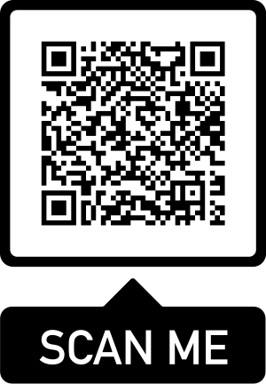
Thank you for your presence!
Scan the QR code to learn more about
Board of Pensions education programs.
Email education@pensions.org with any additional questions, comments, or concerns.
Notes:
The QR code goes to the lifelong learning programs page on pensions.org.

