Slide 1
Soul Collage:
Transformation Through Images and Reflection

Slide 2
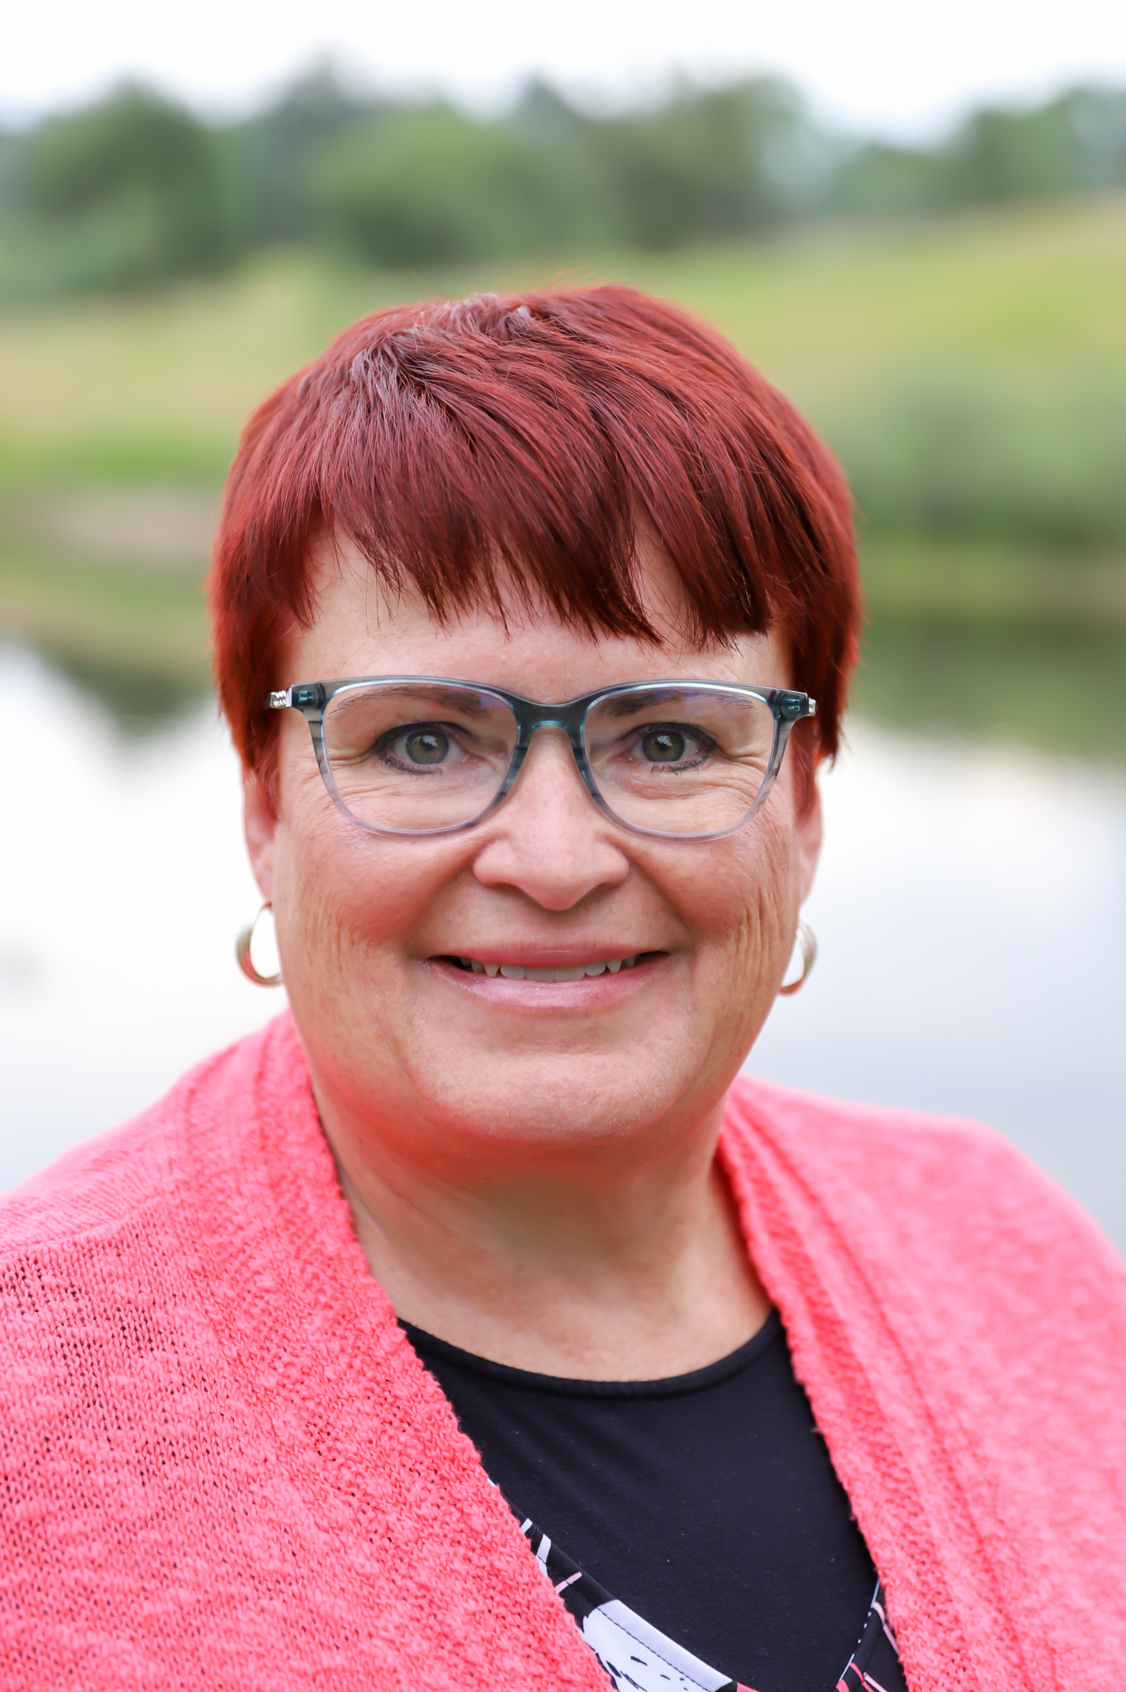
Rev. Denise Shannon
Pastor (PCUSA)
Spiritual Director
Hospice Chaplain
Soul Collage Facilitator
Founder/CEO Sassy Preacher Lady Ministries
Co-Moderator POAMN (Presbyterian Older Adult Ministry Network)

Slide 3
Centering Activity

Slide 4
What is Soul Collage?
SoulCollage® is an expressive arts practice done individually or in community. Founded by Seena B. Frost, the method develops creativity and intuition, encourages self-discovery, and provides personal guidance. SoulCollage® meets you wherever you are on this journey called life. You don’t have to be an artist to make SoulCollage® cards. Anyone can create and enjoy this powerful practice.

Slide 5
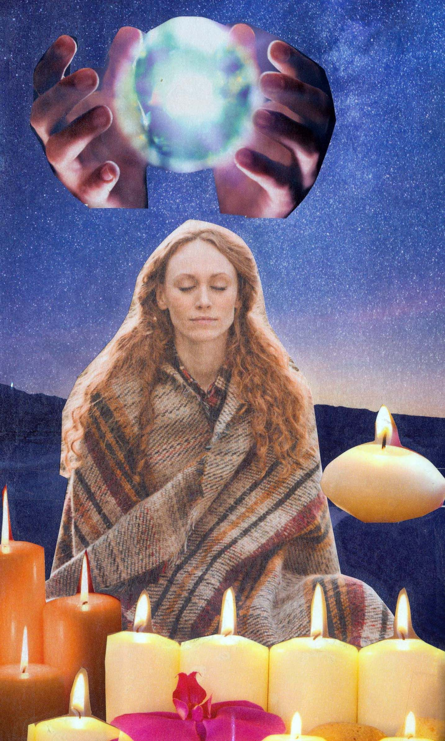
Soul Collage Card Examples

Slide 6
More Examples

Slide 7
Supplies Needed
Images
Glue Stick
Scissors
Card Stock

Slide 8
Your Turn
Step 1…….Pick a Background image from Pile 1.
Step 2…….Pick an image of a person or an animal from Pile 2 or 3.
Step 3…….Lay Background image over cardstock and trim.
Step 4…….Glue background image to cardstock.
Step 5…….Decide where your other image (person or animal) should go.
Step 6…….Glue person or animal image to card.

Slide 9
Reflection Time
I Am One Who……………………..
I Feel…………………………………
This card makes me think…………..
You can use your journal to write down your thoughts.
Share amongst your tablemates.

Slide 10
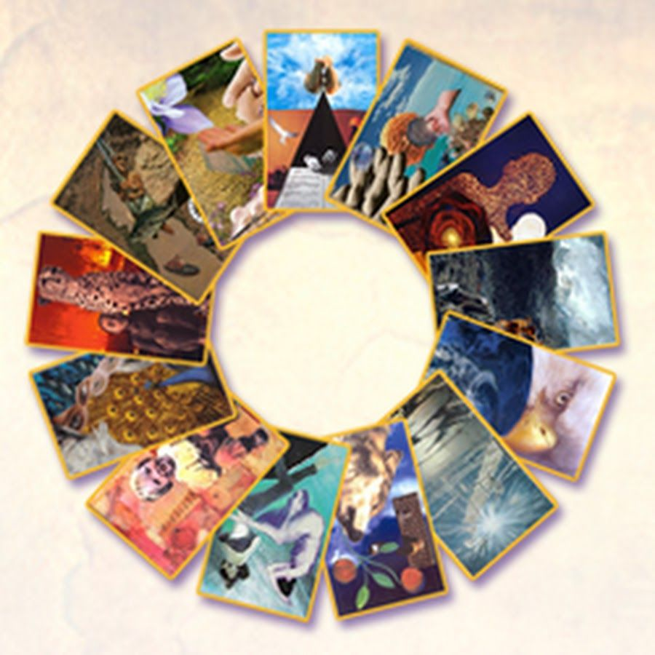
Next Steps
Keep the Card as Is (simple is good!)
Add other images to the card
Refrain from adding words to card (will often direct your thinking)
Create another card…….and then another……and then another.
Take time to reflect.
Return to your cards again and again.

Slide 11
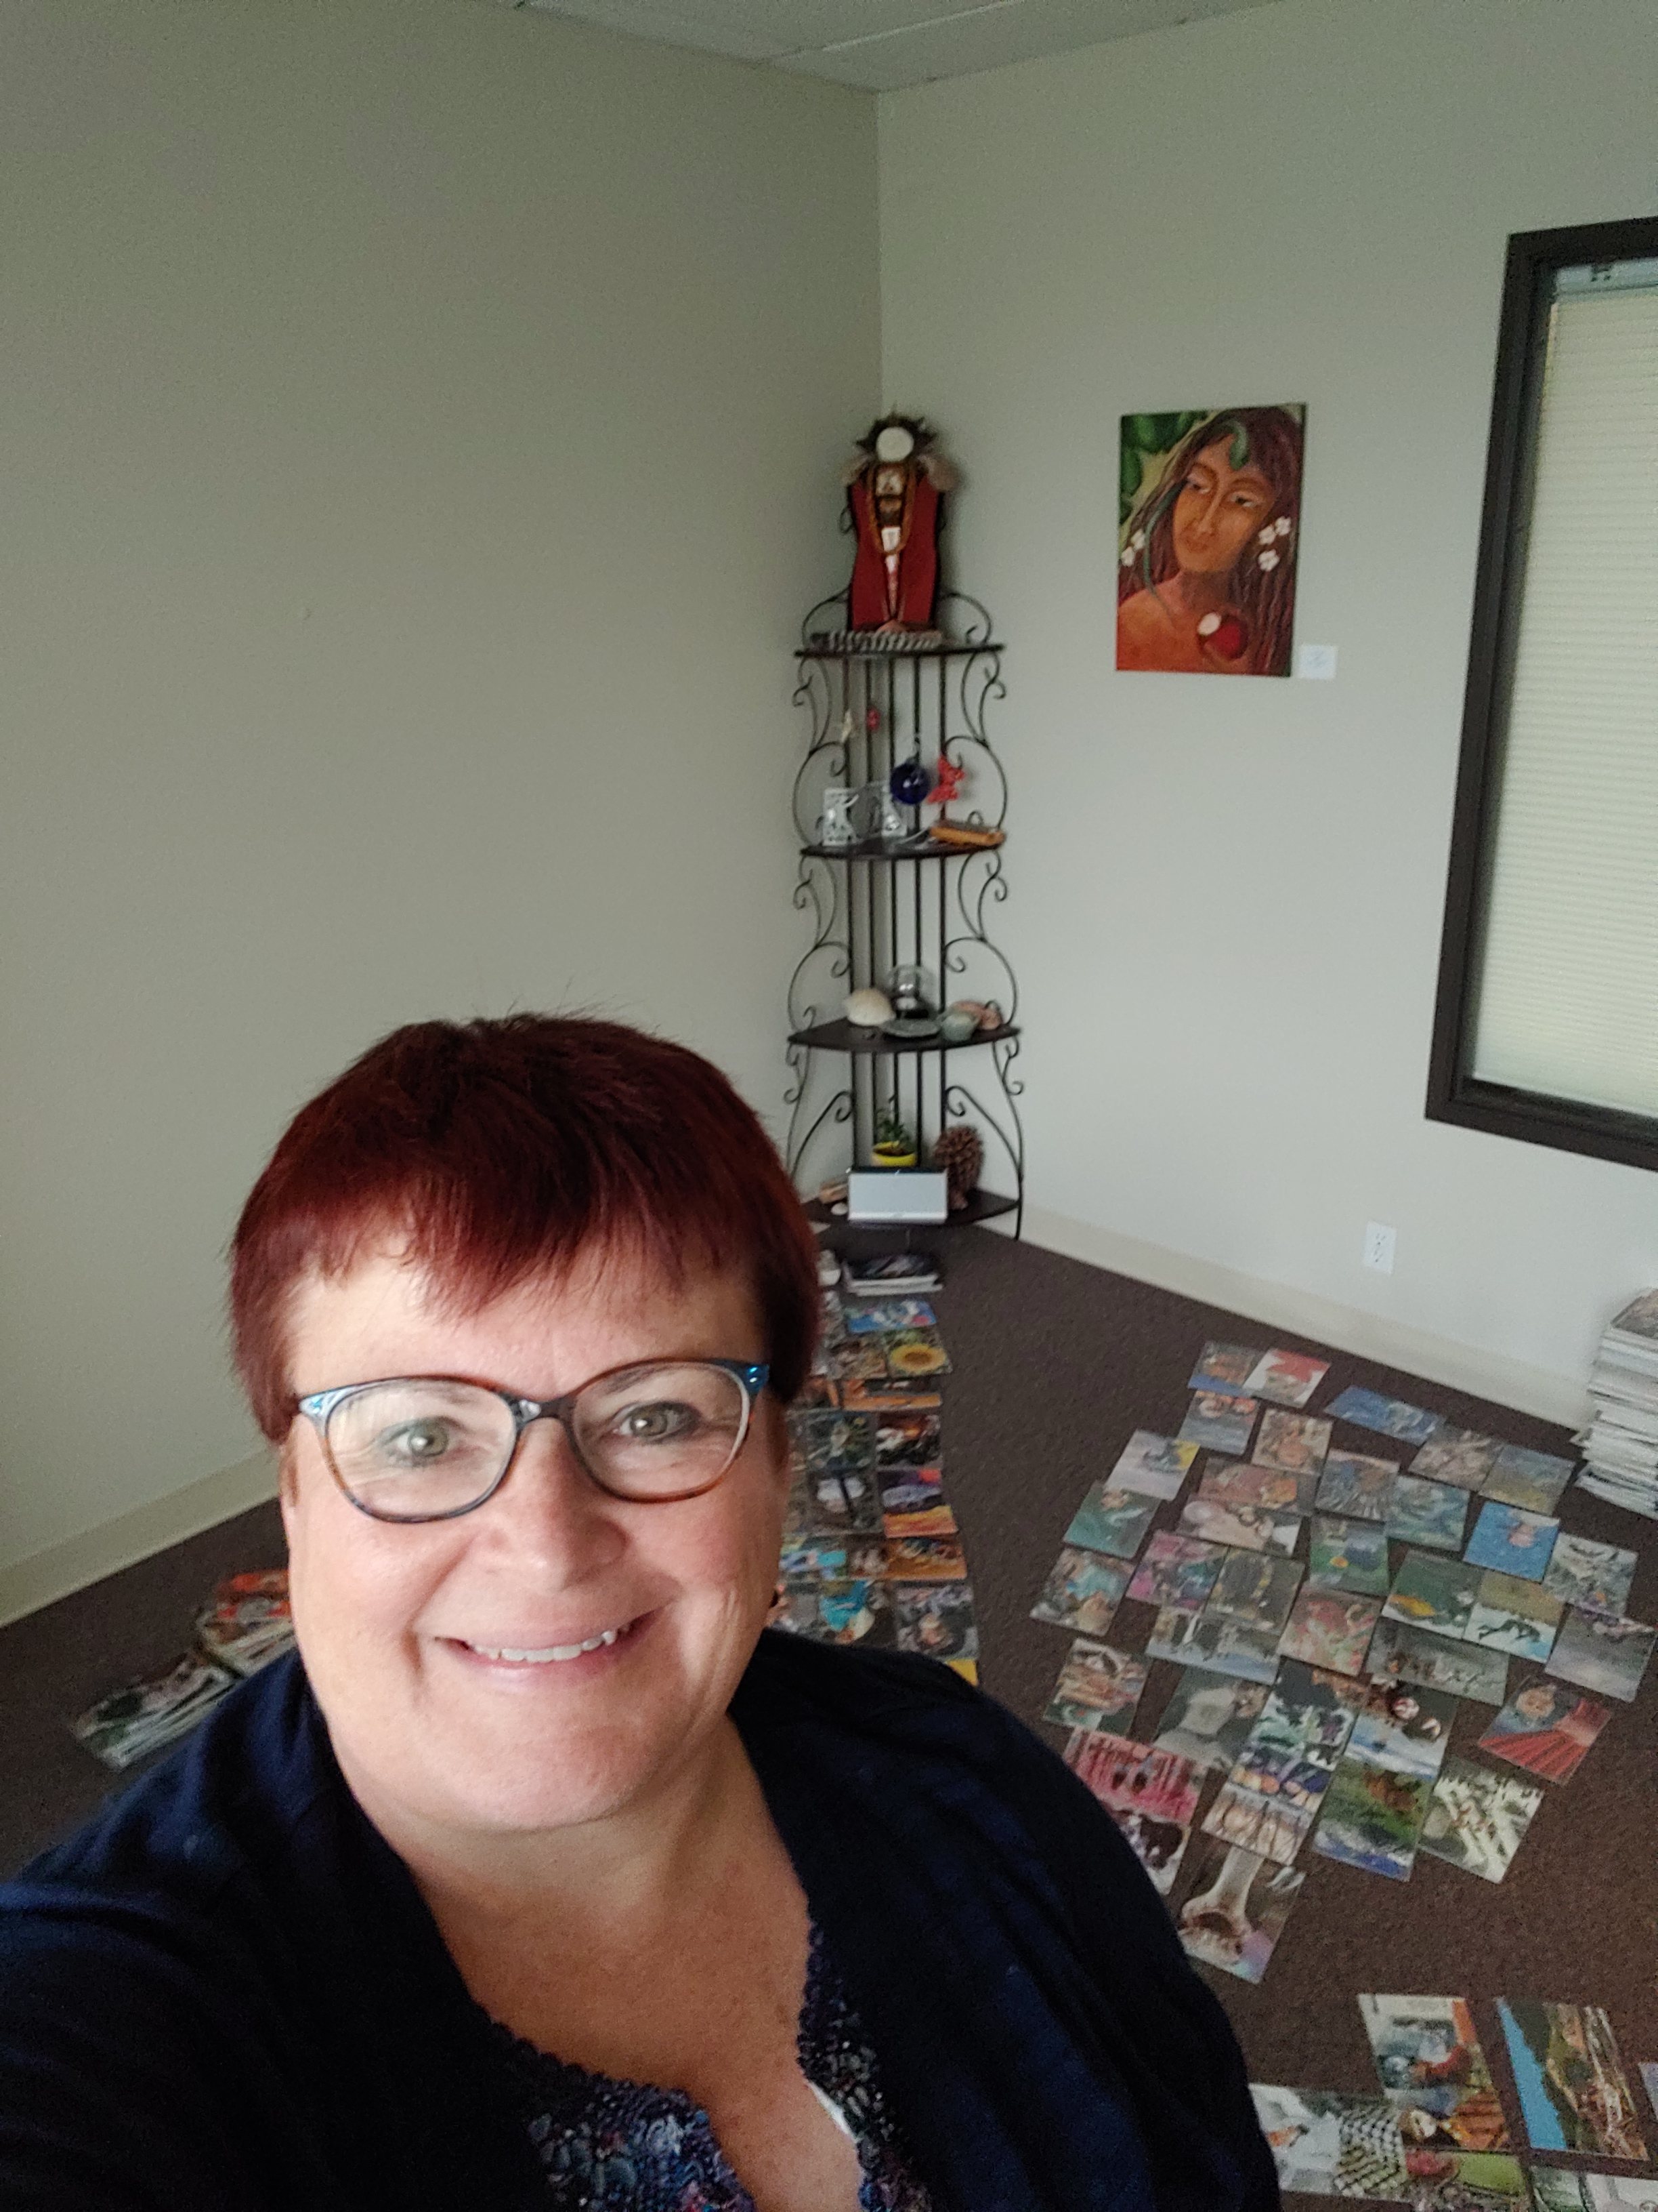
Soul Collage Workshops and Retreats

Slide 12
Questions? Thoughts?
Rev. Denise Shannon
www.sassypreacherlady.org
sassypreacherlady@gmail.com
#303-418-9520

